Slide 1
SPECT
Ramandeep Bagri
Imani Aguiar-Garcia
Grant Kromhout

Slide 2
Agenda
Introduction
Background
Methods
Current Research
Conclusion
Q&A

Slide 3
Introduction

Slide 4
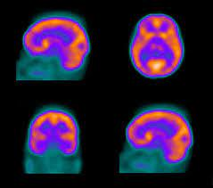
SPECT SCAN
SPECT stands for Single-Photon Emission Computed Tomography
Main goal is to show the blood flows throughout the tissue and organs.
Purpose: Addressing public mental health concerns related to psychology such as depression, suicidal ideation, Autism, seizures impact on the brain, ADHD, ADD, anxiety, and trauma. Overall making the SPECT as psychological tool for daily clinical purposes [Source: Ramandeep et al.].
Utah School of Medicine
Creator: wenht | Credit: Getty Images/iStockphoto
Copyright: wenht
Notes:
Clarify to audience in week 4 we learned about PET, SPECT is using a single photon rather than multiple that may be used in PET

Slide 5
Our objective is to create a pathway for SPECT to become a vital technique in mental health services.
“Overall, the goal is to make the imaging faster, better, safer,
smaller, cheaper, accessible.[22]”
Ramandeep Bagri
[22] Session 1, ENIIUSRA Session 1. You tube channel: NIBIB Gov. Approximated
Accessed 19 April 2022. [Online]. Available: https://www.youtube.com/watch?v=
MSDKGR4gSFQ

Slide 6
Background

Slide 7
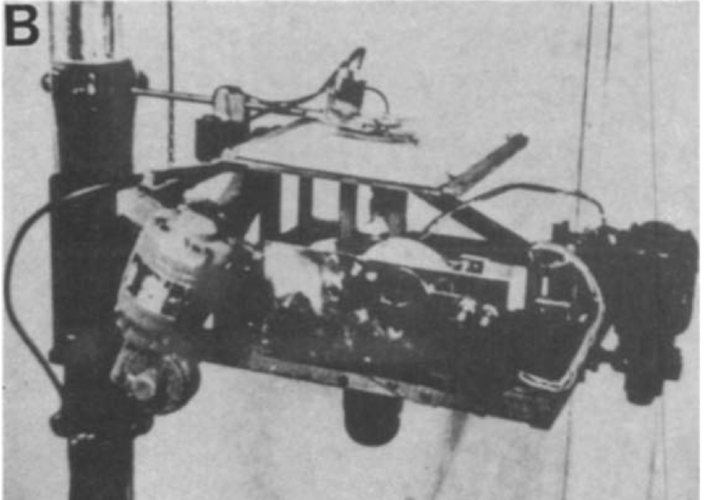
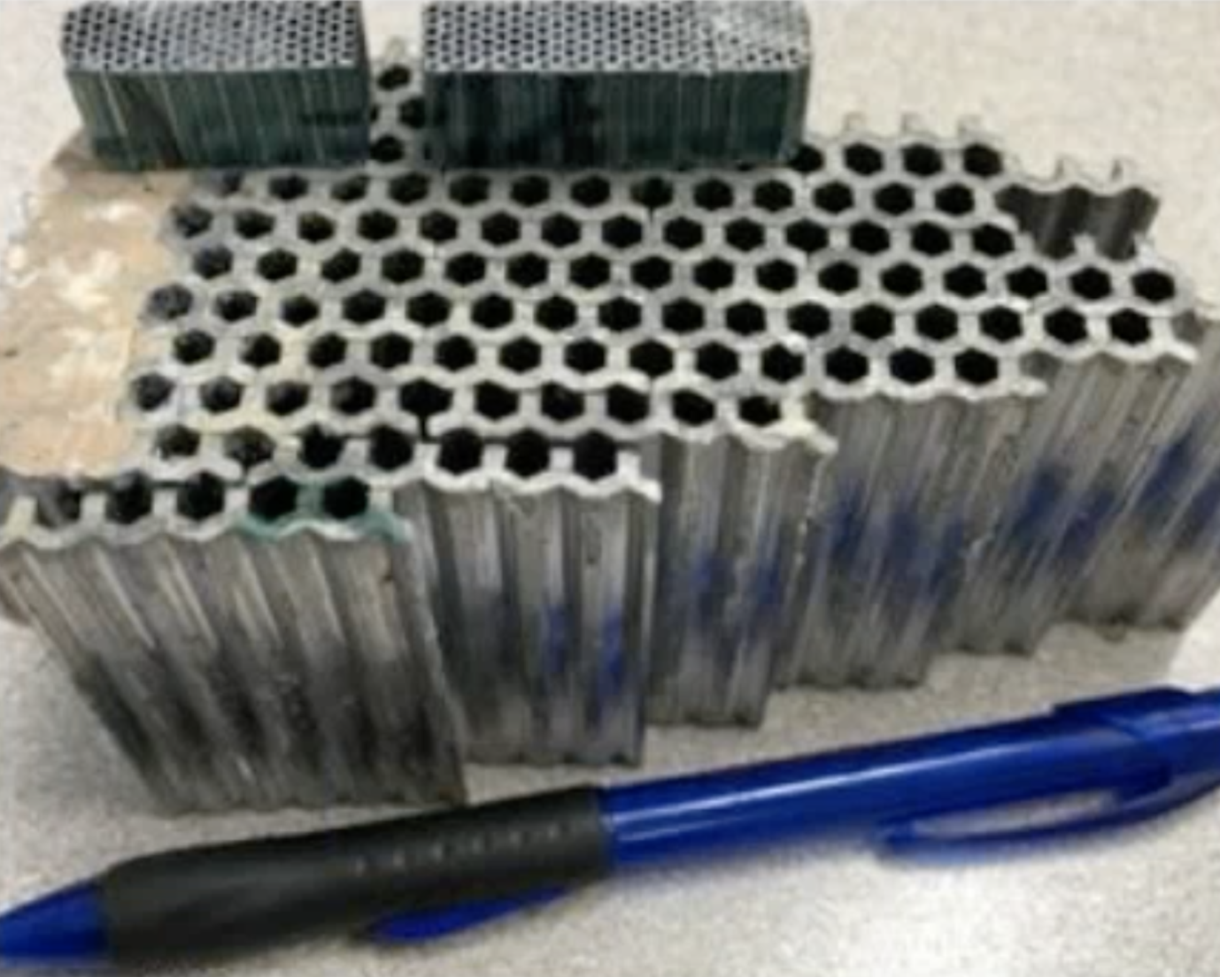
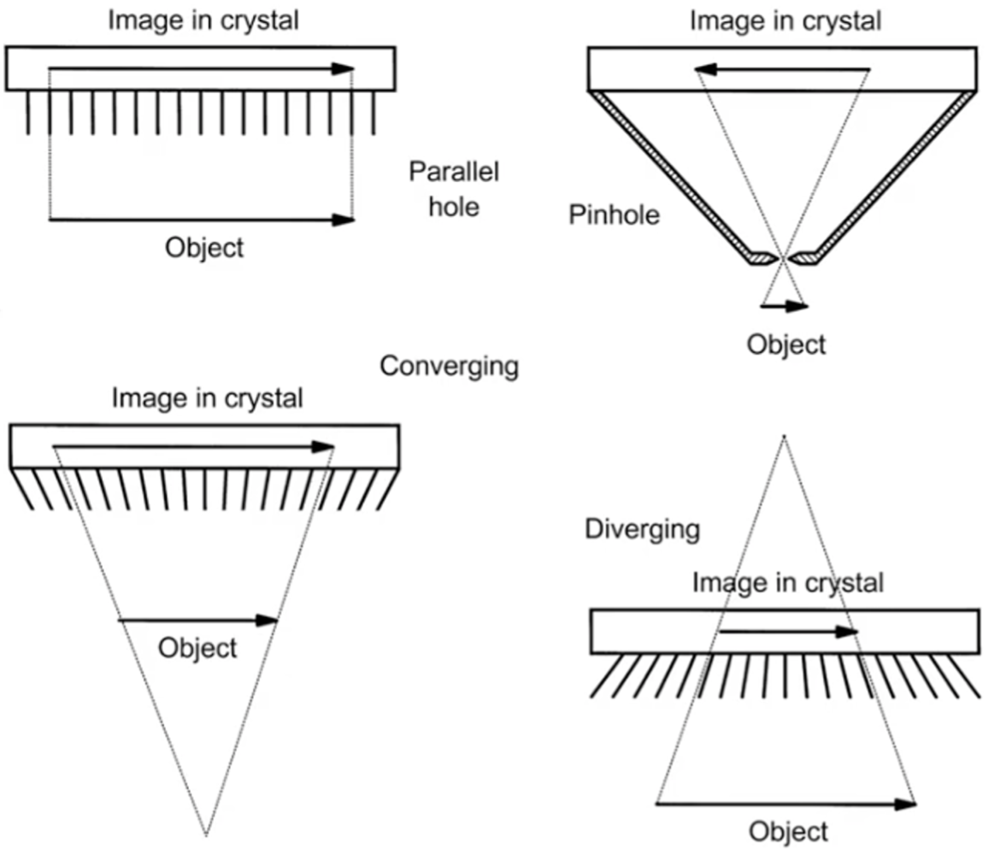
First displayed in 1977, Conventional SPECT
Based on case study by UCSC Alumni [Source: Bagri et al., 2022]
Components of SPECT [Source: Mike Hill, online] (Indirect radiation):
Collimator (lead-Parallel hole)
Scintillation camera,
Photomultiplier Tube,
Photodetector array.
Limitation [Source: Sharir, 2010]
Degrades the performance (due to collimator)
Limited energy resolution
Reduced spatial resolution: Depends on the geometry of the collimator
Limited number of Photomultipliers
Low sensitivity, large dosage,
Increased time for imaging
Rectilinear Scanner (adapted from Blahd,1996
Source: Dr Al-Zube, Online
Collimator (Lead - Parallel hole)
Source: Dr Al-Zube, Online

Slide 8
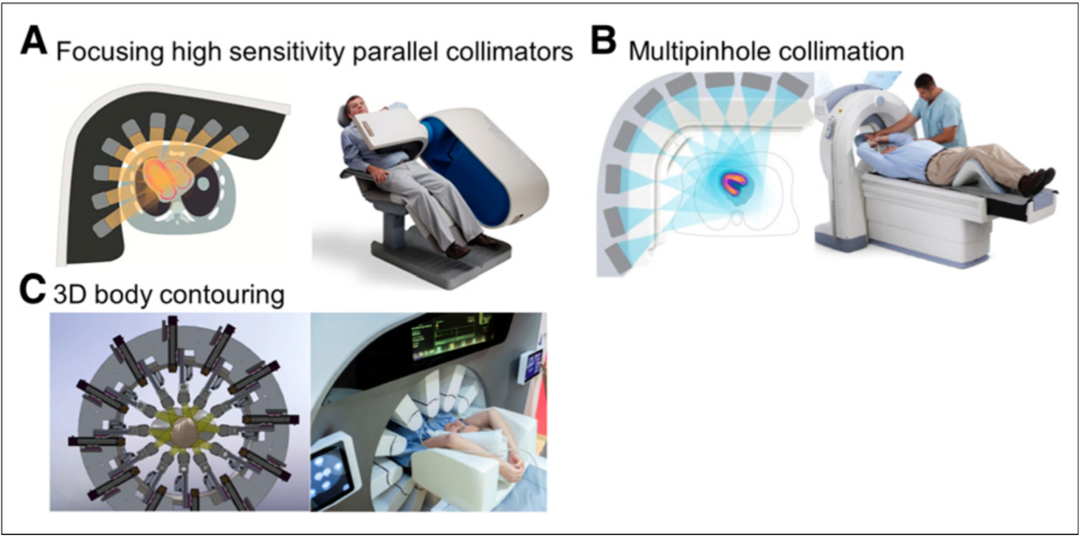
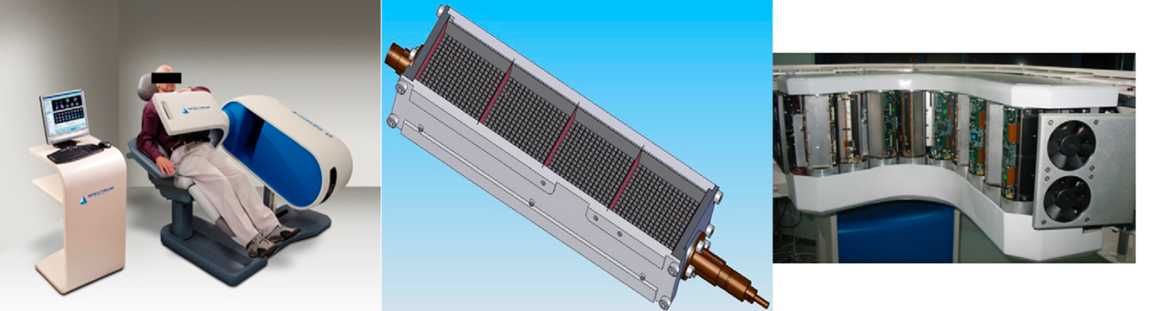
Background advancements are based on following
Gambhir, 2009
Advanced material for Collimators
Different types of Collimater
Different geometry approach
Different intrinsic properties of the crystal or semiconductor material
Spectrum Dynamics - SPECT, Gambhir 2009
Source: Gambhir, Sanjiv S., et al, 2009
Source: Dr Al-Zube, Online

Slide 9
Advancements of SPECT

Slide 10
 | Type of material Collimator | Collimator | Type of detector (Pixel#) | Imaging Reconst
Conventional SPECT (Ogawa,2010) | LEAD | LEHR (Parallel-hole collimators) | 16 x 16 (2 heads) | Iterative (3D), 8 iterations, 4 subset
D-SPECT (Gambhir, 2009) | Lead | LEHR (Parallel-hole collimators and have shorter size 21.7mm) | 16 x 40 | Iterative (3D), 7 iterations, 32 subsets
Discovery, 670c (Gimelli,2021) | Tungsten | Wide energy HR | 32 X 32 | Iterative (3D), 2 iterations, 32 subsets
Discovery, 530c NM (Santarelli, 2021) | Tungsten (pinhole) | LEHR | 32 X 32 | Iterative (3D), 60 iterations, 1 subsets
DSPECT (Valiance X12 Prototype) (Goshen, 2018) | Tungsten | Parallel-Hole Collimators | 16 x 64 | Iterative (3D), 3 iterations, 40 subsets
D-SPECT, Low dose - (Acampa, 2020 | tungsten | LEHR | 64 x 64 | Iterative (3D), 4 iterations, 32 subsets
Notes:
Whats cool about collinatrors is that they are usually made up of one of the following- Gold, Lead, Tungsten, or platinum
Max Penalized Likeli- -hood Iterative,

Slide 11
Our approach to current research

Slide 12
Cd(0.9)Zn(0.1)Te(0.98)Se(0.02) (direct radiation conversion)
Source: Chaudhuri, 2020
Maintaining potential difference
Ionizing radiation
Create e(-), hole pair
Charges drift
Create charge pairs
CZTS (any semiconductor)
Two things happen: may recombine or lost forever
If there is any manufacturing defect in the crystal
Charge carriers trap these defects
Induce charge on resp. electrode
Permanent charge trap -> deposit partial charge on collecting electrons (ballistic deficit)
Thermal detrapping -> trapped charge out due to thermal excitation -> deposit on electrode
Its a function of the instantaneous position of charge carriers
Charge collection time
Mean drift times before a charge is trapped
Mean lifetime before detrapping occurs

Slide 13
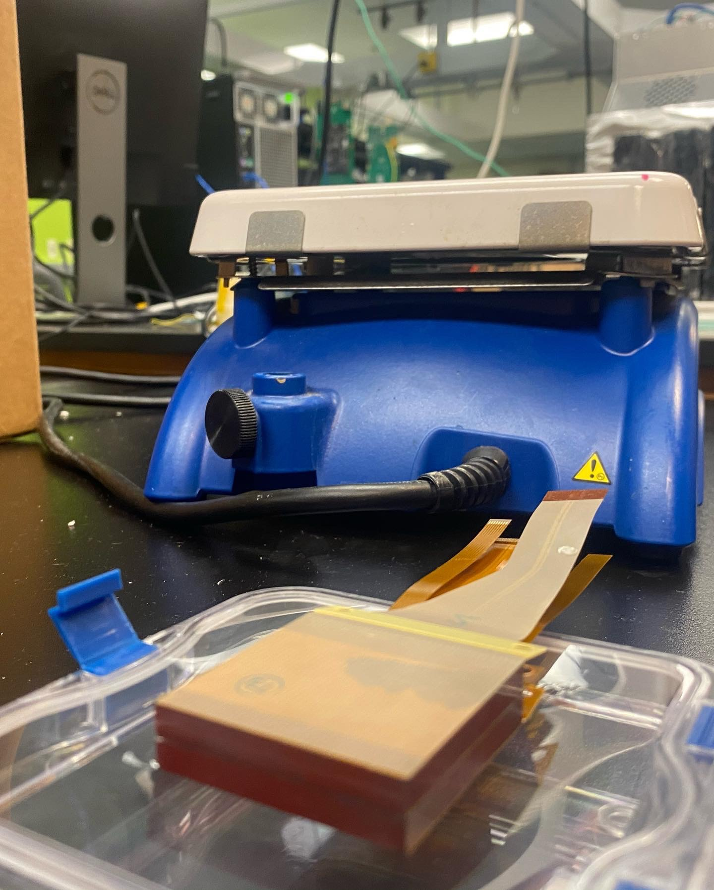
Currently:
Cadmium Zinc Telluride (CZT)
Thinner alternative to NaI crystals
Lower stopping power - lower photon sensitivity
Does not respond well to high-energy photon emitters (364 keV)
Requires less radiation exposure compared to NaI
Higher spatial energy resolution
Applied Methods:
D-SPECT:
1 High sensitivity tungsten collimator
9 detectors focused on heart - patient in seated position
More sensitive than Disc. 530c
Discovery NM 530c
19 detectors in curved array - patient supine
Pinhole collimators
Best for cardiac imagery
Image is taken at Dr. Shiva’s lab, UCSC, Captured by Aguiar-Garcia, I on May 19, 2022

Slide 14
CZTS (Cd0.9Zn0.1Te0.98Se0.02)
Cheaper and more environmentally friendly
Advantages in crystal growth yield - 90% of crystal produced is detector grade
Energy resolution of 0.9% for 662 keV gamma
rays
Lower concentration of terrarium inclusion which cause imaging defects
Lower crystal faults such as sub-grain boundaries (SGB) - better charge-transport uniformity
Image is taken at Dr. Shiva’s lab, UCSC, Captured by Aguiar-Garcia, I on May 19, 2022

Slide 15
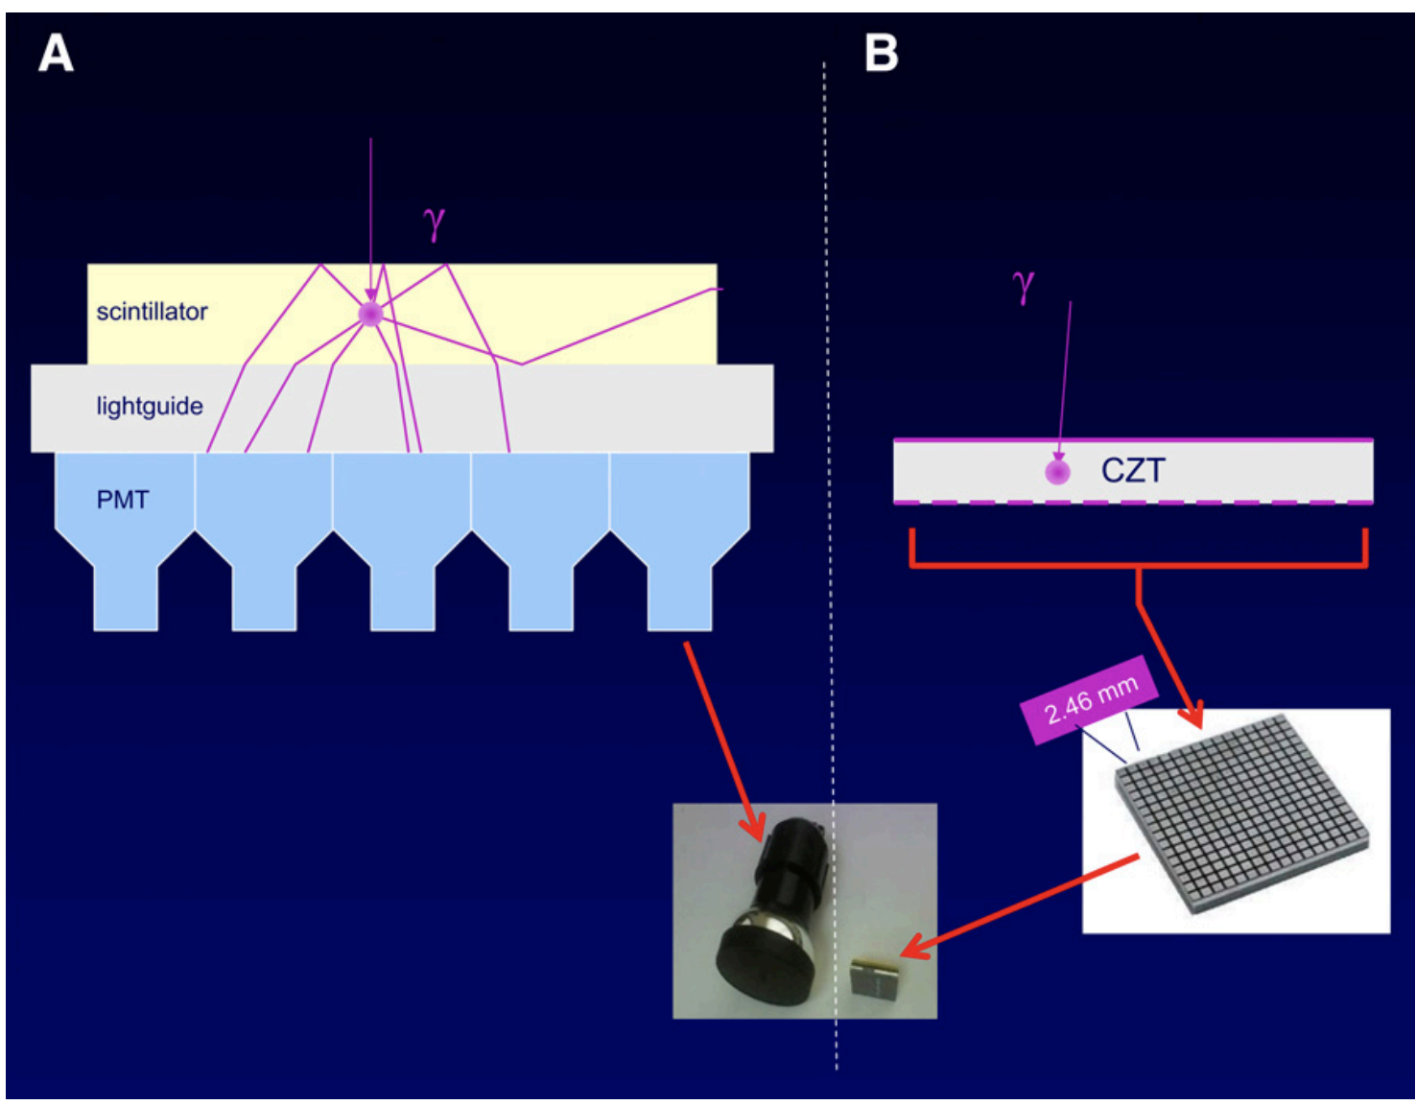
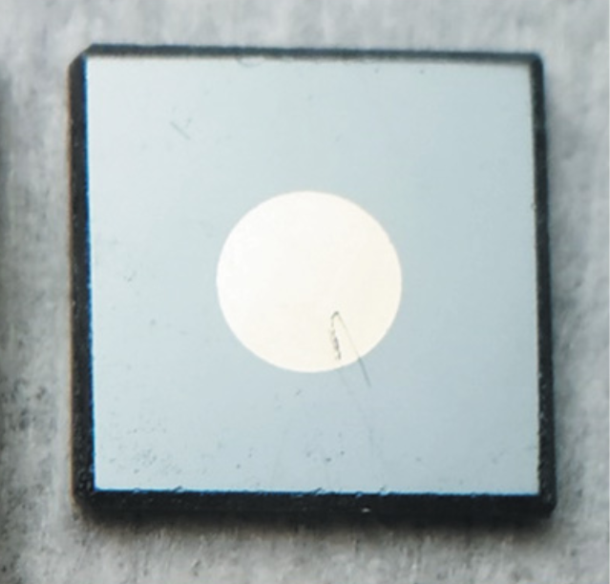
C: Proposed Approach: (influenced from Garcia, 2011)
CZTS
REPLACE
HOIP/Gold (Thin film deposition over CZTS)
Source: Brenner, 2016
Source:Chaudhuri, 2020
2nd proposed experiment:
1st proposed experiment
Source: Garcia, 2011
Notes:
Advantages: Hybrid organic–inorganic perovskites (HOIP)
low-cost semiconductors with intriguing charge-transport properties

Slide 16
Advantages of SPECT and CZTS

Slide 17
Advantages of SPECT with CZTS
SPECT CZTS is cheaper as compared to SPECT CZT
All psychological or nervous system clinics will be able to afford)
Scanning will become available in abundance.
Cheaper and affordable mental health.
Example, case study

Slide 18
Concluding thoughts…

Slide 19
To gather all these ideas
“An advantage here to call for SPECT technology is that more
the half-life of the tracer, the imaging will be easier and cheaper as compared to other
imaging technologies available. Cheaper technology likely have more advantages to be used
for daily clinical psychological analysis’s and treat patients with evidence for problems such
as Autism, anxiety, depression, unforeseen behavioral issues or any psychological problem
related to brain activity” -Ramandeep Bagri

Slide 20
References
Case study ECE 80: Recent Developments of SPECT system: A Review, [Ramandeep Bagri, Imani Aguiar-Garcia, Grant Kromhout]
W. H. Blahd, “Ben cassen and the development of the rectilinear scanner,” in Seminars in nuclear medicine, vol. 26, no. 3. Elsevier, 1996, pp. 165–170.
Mike Hill, Training Support Manager IT Manager at Universal Medical, Gamma Camera and Correction Fundamentals. You tube channel: MD Publishing, Inc. Approximated Accessed 22 April 2022. [Online]. Available: https://www.youtube.com/watch?v=NKVyHFk01lY
T. Sharir, P. J. Slomka, and D. S. Berman, “Solid-state spect technology: fast and furious,” Journal of nuclear cardiology, vol. 17, no. 5, pp. 890–896, 2010.
Garcia, Ernest V., Tracy L. Faber, and Fabio P. Esteves. "Cardiac dedicated ultrafast SPECT cameras: new designs and clinical implications." Journal of Nuclear Medicine 52.2 (2011): 210-217.
Chaudhuri, Sandeep K., et al. "Charge transport properties in CdZnTeSe semiconductor room-temperature γ-ray detectors." Journal of Applied Physics 127.24 (2020): 245706.
Brenner, Thomas M., et al. "Hybrid organic—inorganic perovskites: low-cost semiconductors with intriguing charge-transport properties." Nature Reviews Materials 1.1 (2016): 1-16.
Chaudhuri, Sandeep K., Mohsin Sajjad, and Krishna C. Mandal. "Pulse-shape analysis in Cd0. 9Zn0. 1Te0. 98Se0. 02 room-temperature radiation detectors." Applied Physics Letters 116.16 (2020): 162107.
Gambhir, Sanjiv S., et al. "A novel high-sensitivity rapid-acquisition single-photon cardiac imaging camera." Journal of Nuclear Medicine 50.4 (2009): 635-643.

Slide 21
References
Dr Al-Zube, How to Generate Nuclear Medical Images? — Gamma (Anger Scintillation) Camera Basics — Dr. Al-Zube. You tube channel: Loay AlZube. Approximated Accessed 22 April 2022. [Online]. Available: https://www.youtube.com/watch?v=4wUIu2Y KKs
S. S. Gambhir, D. S. Berman, J. Ziffer, M. Nagler, M. Sandler, J. Patton, B. Hutton, T. Sharir, S. B. Haim, and S. B. Haim, “A novel high-sensitivity rapid-acquisition single-photon cardiac imaging camera,” Journal of Nuclear Medicine, vol. 50, no. 4, pp. 635–643, 2009.
Gimelli, Alessia, et al. "Head-to-head comparison of a CZT-based all-purpose SPECT camera and a dedicated CZT cardiac device for myocardial perfusion and functional analysis." Journal of Nuclear Cardiology 28.4 (2021): 1323-1330.
Santarelli, Maria Filomena, et al. "CZT Detectors-Based SPECT Imaging: How Detector and Collimator Arrangement Can Determine the Overall Performance of the Tomograph." Electronics 10.18 (2021): 2230.
Goshen, Elinor, et al. "Feasibility study of a novel general purpose CZT-based digital SPECT camera: initial clinical results." EJNMMI physics 5.1 (2018): 1-12.
Ogawa, Koichi, and Masaaki Muraishi. "Feasibility study on an ultra-high-resolution SPECT with CdTe detectors." IEEE Transactions on Nuclear Science 57.1 (2010): 17-24.
Acampa, Wanda, et al. "Low-dose dynamic myocardial perfusion imaging by CZT-SPECT in the identification of obstructive coronary artery disease." European Journal of Nuclear Medicine and Molecular Imaging 47.7 (2020): 1705-1712.

Slide 22
Thank you for listening
Q&A

